Slide 1

PRACTICE
Slide edition in Power Point
Figma and Power Point ae very similar
For each 4 activities , compare the way on Figma with the way to work on Power Point
Then discuss in group about what you have found
Set
Navigate
Select
Create
Align
Position
Size
Radius
Resize with radio
Zooms
Edition view
Animation view
Shapes
Shapes
Slides
Shapes
Text
Table
Pictures
Lines
Curves
Align
Distribute
alignment guides (red lines)
Guides and grid
Duplicate
Copy / Paste
Copy paste properties
Colors
Color dropper
Strokes
Fonts
Notes:
TRAINER :
Give a very brief introduction of all mentioned features

Slide 2

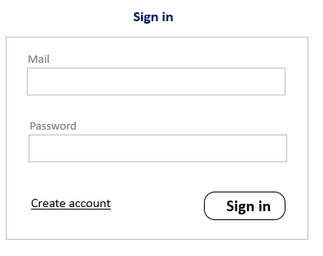
PRACTICE
Activity 1
15 MIN

Slide 3
PRACTICE
Activity 2
GRAPHIC ELEMENTS
15 MIN
Sign in
Mail
Password
Create account
Sign in

Slide 4
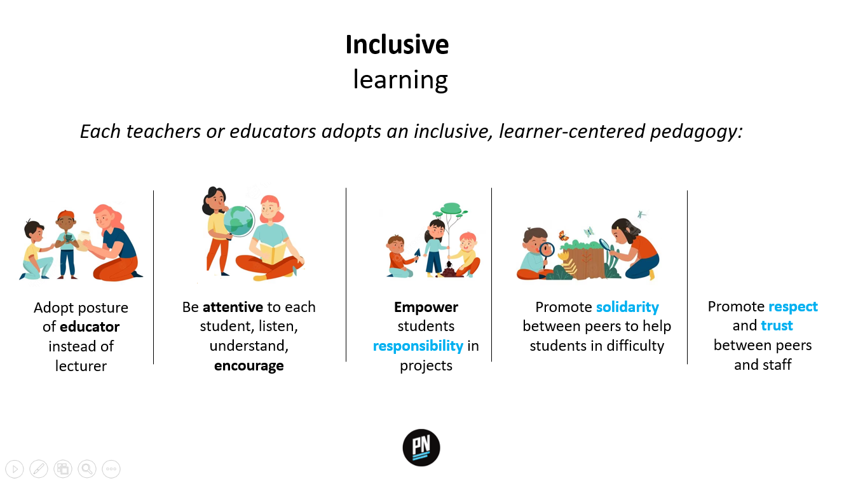
PRACTICE
Activity 2
15 MIN

Slide 5





PRACTICE
Activity 2
15 MIN
Inclusive
learning
Each teachers or educators adopts an inclusive, learner-centered pedagogy:
Adopt posture of educator instead of lecturer
Be attentive to each student, listen, understand, encourage
Empower students responsibility in projects
Promote solidarity between peers to help students in difficulty
Promote respect and trust between peers and staff

Slide 6
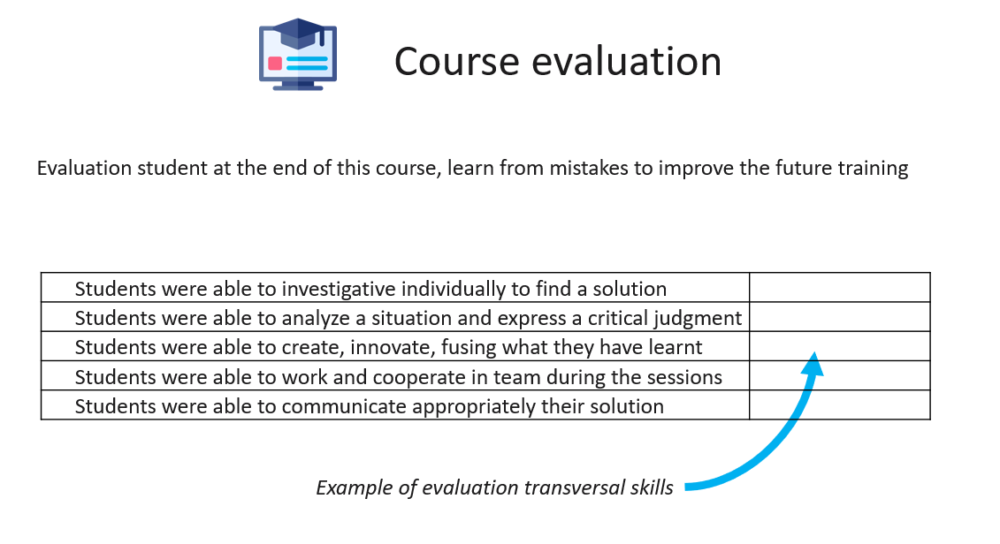
PRACTICE
Activity 3
15 MIN

Slide 7

PRACTICE
Activity 2
15 MIN
Course evaluation
Evaluation student at the end of this course, learn from mistakes to improve the future training
Students were able to investigative individually to find a solution
Students were able to analyze a situation and express a critical judgment
Students were able to create, innovate, fusing what they have learnt
Students were able to work and cooperate in team during the sessions
Students were able to communicate appropriately their solution
Example of evaluation transversal skills

Slide 8

PRACTICE
Activity 4
15 MIN

Slide 9





PRACTICE
Activity 4
15 MIN
CERTIFICATE OF PARTICIPATION
Presented to
SOPHON SEN PHEARUN CHHUN KHY PHAT
For their participation in eight hours of IT-related challenges during Passerelles numériques inaugural Halloween Cup on October 28, 2021.
Third Place in Coding Challenge
Third place in coding challenge
Ronan OGOR
IT Coordinator & Pedagogical advisor
of Passerelles numériques Cambodia
Jun Rey ANSING
Innovative Technology Coordinator
of Passerelles numériques Philippines
Lucas SINROD
IT & Training Manager
of Passerelles numériques Vietnam

